Slide 1
Promotion Mix: Bayesian Process Training
May 6, 2008

Slide 2
Day 1 Agenda
Overview of Promo Mix Engagement
Overview of Bayesian Process Flow
Data
  Formatting
  QC
  Exploration
Prior Calculations
Baseline Model Overview
Practice (Data, Priors, Baseline Model)

Slide 3
Day 1 Agenda
Overview of Promo Mix Engagement
Overview of Bayesian Process Flow
Data
  Formatting
  QC
  Exploration
Prior Calculations
Baseline Model Overview
Practice (Data, Priors, Baseline Model)

Slide 4
A key challenge for pharmaceutical firms is to optimize commercial investment
Operating Challenges:
Key Insights Needed:
Understand which investment areas offer the best opportunities to eliminate less productive sales, marketing, and infrastructure spending
Eliminate commercial spending that is no longer generating value
1
Re-allocate investment to activities that drive greater value in the current market
Identify investments which contribute most strongly to revenue and profitability, and determine how they can be emphasized to maximize returns
2

Slide 5
IMS helps our clients overcome their challenges around promotional allocation through an engagement that ultimately optimizes the marketing plan and increases brand profits
IMS Health Commercial Effectiveness Consulting
Promotion Management
Understanding of effectiveness of past promotions
Insights into outcomes due to future promotion
Optimized spend and increased profits
Client’s Promotional Allocation Issues
+
=

Slide 6
Our Promo Mix process has the following approach
1
2
3
4
5
Data collection
Data review
Econ Modeling
Model Output
Mix Allocation
Data collection is the fundamental starting point for analysis. We utilize our extensive Rx data to measure the Rx demand. We combine these data with both client’s promotional data as well as our own for analysis.
Upon receipt of the data we review the data through visualization and summary statistics.
We review our findings with the client in order to ensure a mutual understanding of the brand and market.
Econometric modeling is the process by which we tease out insight into the contribution of promotional activity, ROI, marginal ROI and response curves. We use advanced statistical methods to estimate the relationships between promotion and demand while controlling for external factors.
Our analysis leads directly to findings and recommendations that relate to the financial performance of the brand, and the means to maximize that performance. We communicate these findings using key metrics such as contribution, ROI, marginal ROI and the optimization results.
Optimizing the mix of promotion spend is based on the promotion response curves from the econometric model. We can optimize the promotion mix to address three objectives:
1) Maximize profits
2) Meet revenue targets
3) Maximize sales with a given budget.

Slide 7
The data collection is a critical phase in the process
1
2
3
4
5
Data collection
Data review
Econ Modeling
Model Output
Mix Allocation
The data is the basis of our understanding of the historical impact of promotion channels and therefore directly impacts the recommendations of the optimal promotion mix
  Consequently, quality data is paramount to the success of the project
  “Garbage-in, Garbage-Out”
We utilize IMS’ prescription databases, sales database and client sales data in order to measure the demand
  We run models at various levels including National, regional, and physician level.
We utilize both IMS and client promotional data
  Call files: Details and Samples
  DTC GRPs and Spend
  Journal Spend
  Meetings and Events
  Web Advertising
  Etc…

Slide 8
After receiving the data we QC it and prepare a report showing summaries, financial calculations and the trends in the data over the historical period
1
2
3
4
5
Data collection
Data review
Econ Modeling
Model Output
Mix Allocation
Summaries : We summarize all data to the national and segment level if applicable in order to ensure that the control totals match the client’s expectations.
Financial Calculations : We multiply the units for all metrics by their respective cost per unit in order to create a calculated annual spend. We then compare this to the client provided annual spend to ensure similarity.
Time Series Trend : We chart the data over time and have the client verify the historical allocation. This also allows us to get an initial understanding of the trends, efforts and strategies over the model period.
This is a collaborative process between IMS and the client to ensure mutual understanding of the data

Slide 9
1
2
3
4
5
Data collection
Data review
Econ Modeling
Model Output
Mix Allocation
Once we have ensured that we have accurate data we create cross-sectional time-series regression models in order to estimate the contribution of promotion.
We employ a “stocking” algorithm to the promotional data that captures both the short-term and the long-term impact of the effort.
We utilize a Fractional Power model that allows us to estimate the overall contribution of each channel as well as the level of diminishing returns
The Fractional Power model is a separatable model so it allows us to estimate mutually exclusive impacts for each variable

Slide 10
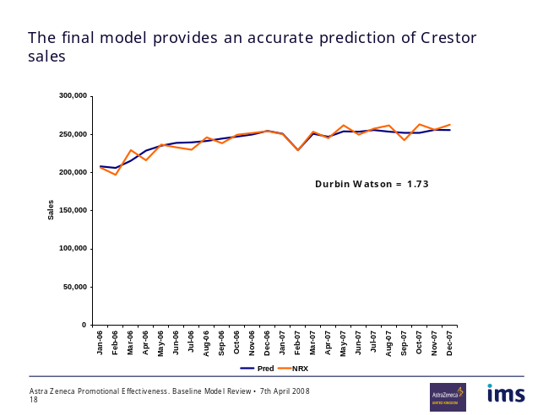
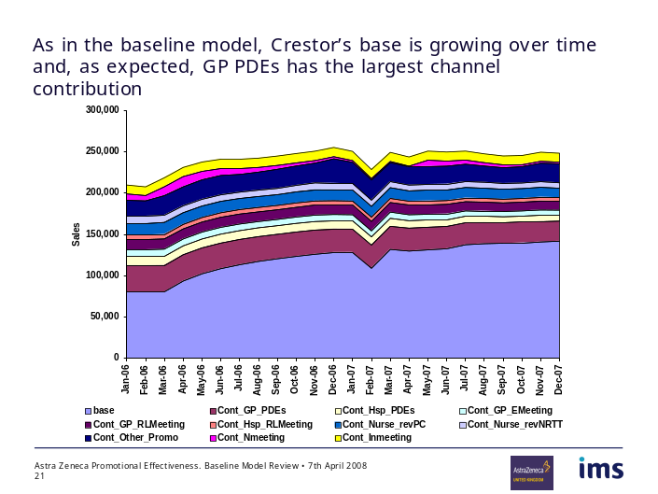
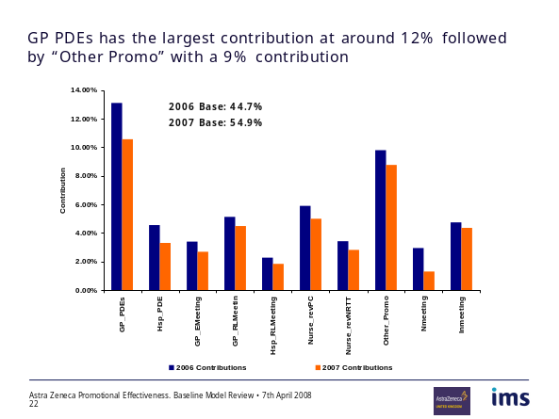
We aim to create robust models that capture the variation in the dependent variable and accurately estimate the impact due to each controlling variable and each promotional channel

Slide 11
We deliver key metrics for interpretation as an output of our analysis
1
2
3
4
5
Data collection
Data review
Econ Modeling
Model Output
Mix Allocation
Contribution: Percentage of TRx or revenue delivered by each promotion channel
Return on investment (ROI): measures the return relative to expenditure
  Contribution to operating income, divided by total cost
Revenue curves, costs and profit: shows operating income vs. cost and profit over a range of marketing spending
Marginal ROI: measures the Marginal return per additional dollar of spend.

Slide 12
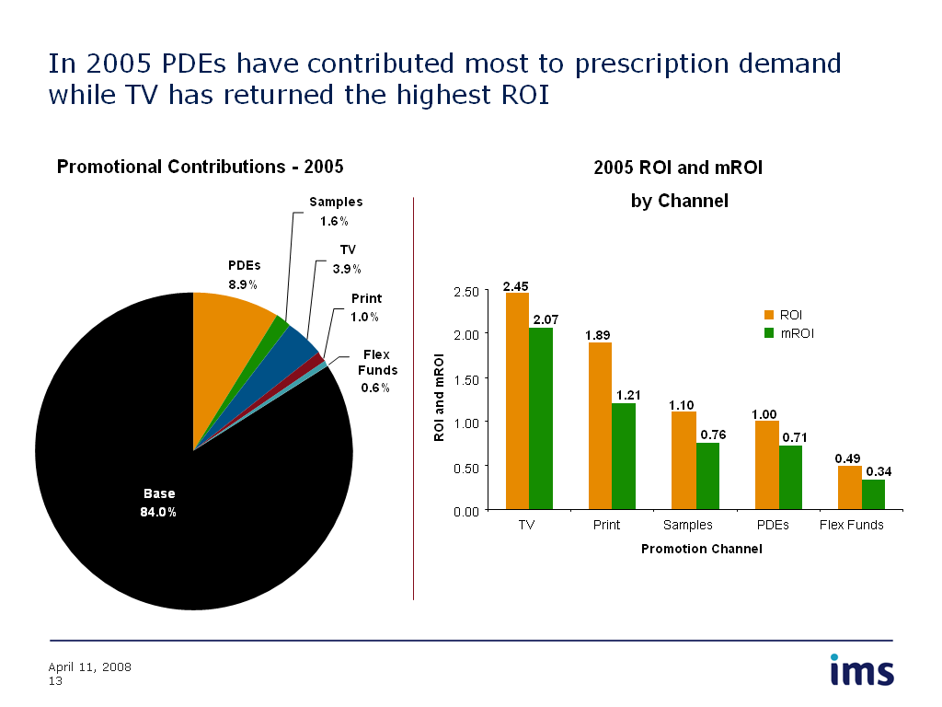
Contributions and ROIS give a description of the historical impact from each channel
Notes:
Base: regardless of promoted or not

Slide 13
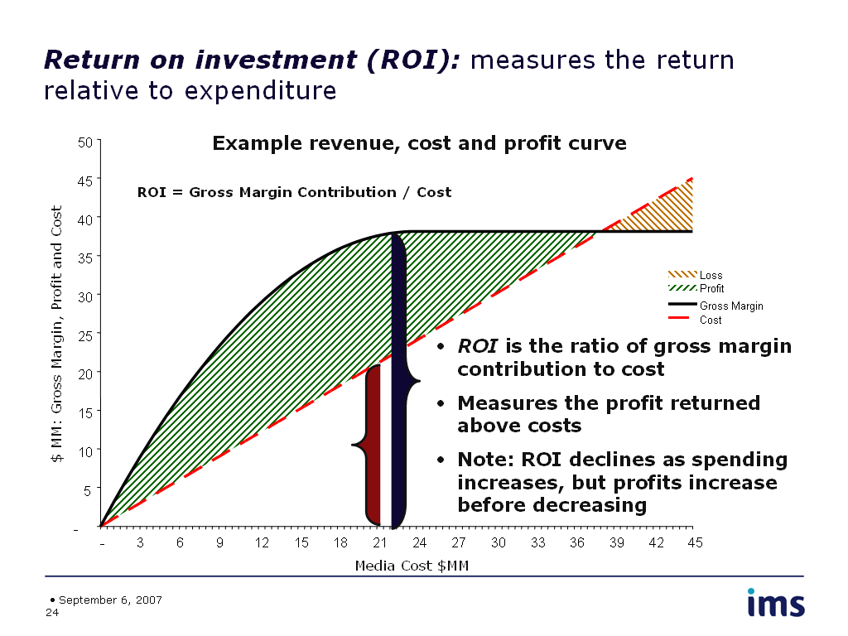
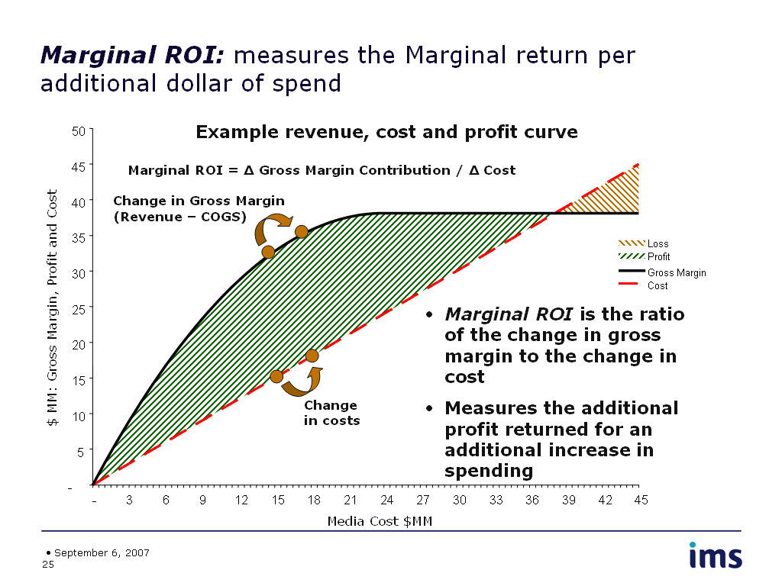
We create response and marginal ROI curves that are used to develop optimal spending recommendations for each channel
Notes:
For each channel

Slide 14
Once the historical econometric model is estimated, we optimize the promotion mix to provide three scenarios based on different objectives:
1) Maximize profits,
2) Hit a sales target with the least spend, or
3) Maximize sales with a given budget across all channels
1
2
3
4
5
Data collection
Data review
Econ Modeling
Model Output
Mix Allocation
Promotion spending decision
Optimal promotion mix
Profits are maximized
Sales force
22%
at the level where the
difference between
Loss
Sampling /
revenues and costs
Free trial
18%
are greatest.
Break
-
even
Network TV
14%
Profit
Direct mail
11%
Dollars: Revenue, Cost
Profit
Cable TV
9%
Loss
Revenue
Magazine
7%
Optimal profit
Cost
Newspaper
6%
National Radio
5%
Spot TV
4%
Optimal magazine spending
Spot Radio
3%
Promotions are best budgeted at the level that maximizes profits
Notes:
For each channel

Slide 15
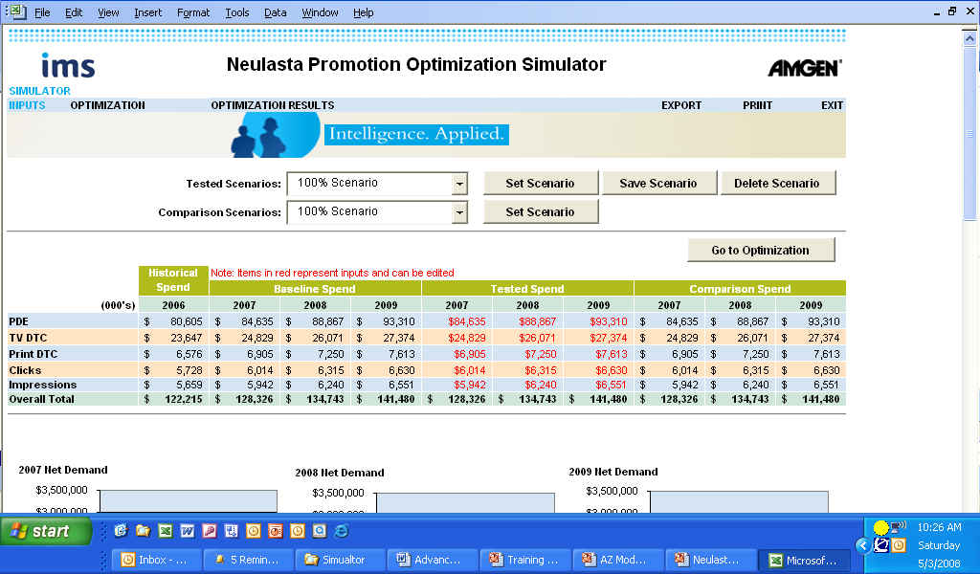
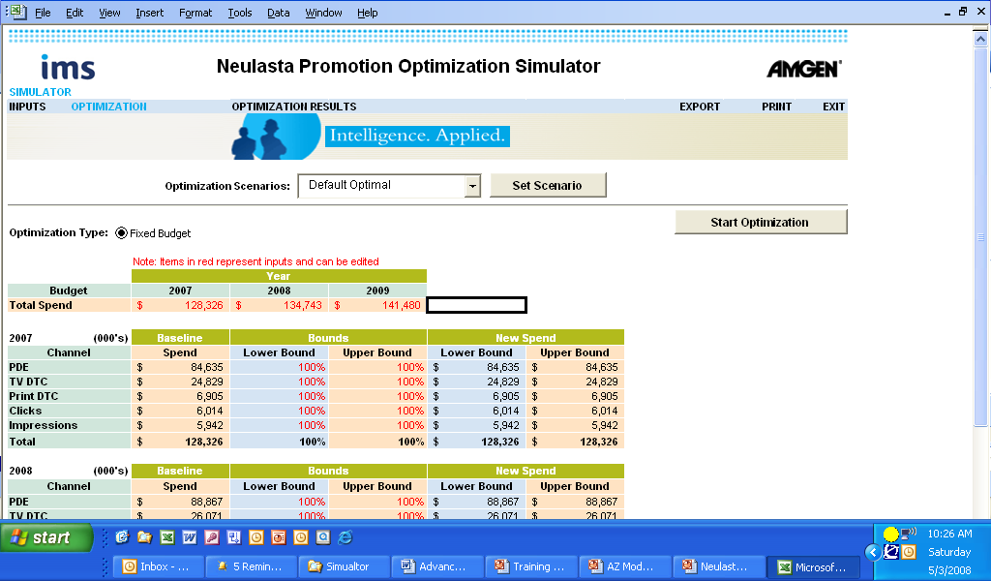
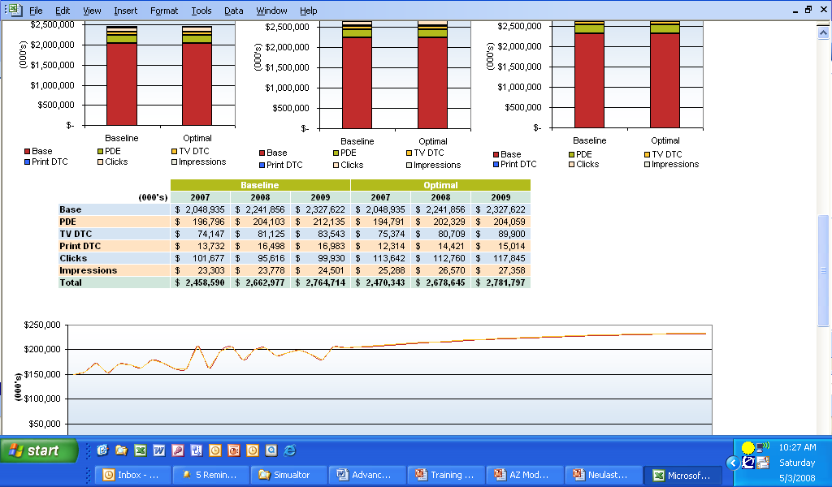
We create an Excel based simulator that allows the client to run “what-if” and “optimization” scenarios based off of different spend levels and market assumptions

Slide 16
Day 1 Agenda
Overview of Promo Mix Engagement
Overview of Bayesian Process Flow
Data
  Formatting
  QC
  Exploration
Prior Calculations
Baseline Model Overview
Practice (Data, Priors, Baseline Model)

Slide 17
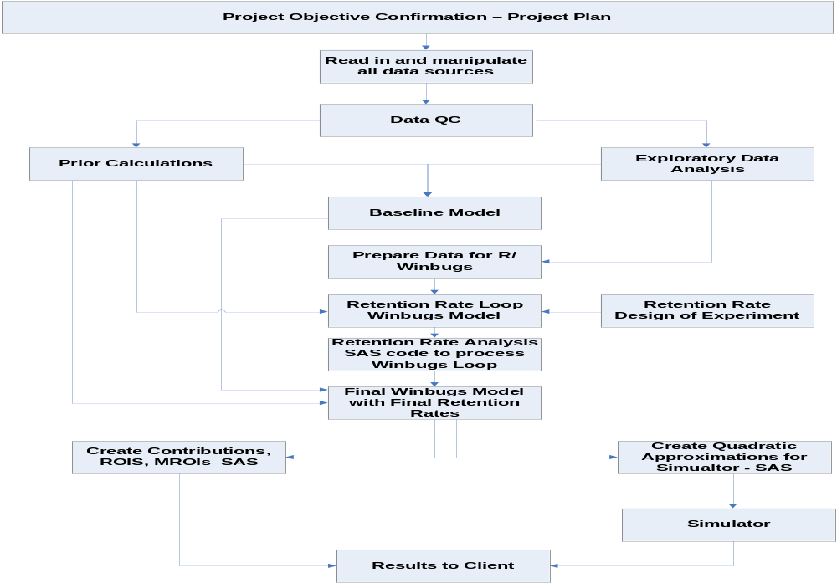
Process Flow: Bayesian Fractional Power Methodology
Notes:
Different combination of retention rates to determine the best one

Slide 18
Day 1 Agenda
Overview of Promo Mix Engagement\
Overview of Bayesian Process Flow
Data
  Formatting
  QC
  Exploration
Prior Calculations
Baseline Model Overview
Practice (Data, Priors, Baseline Model)

Slide 19
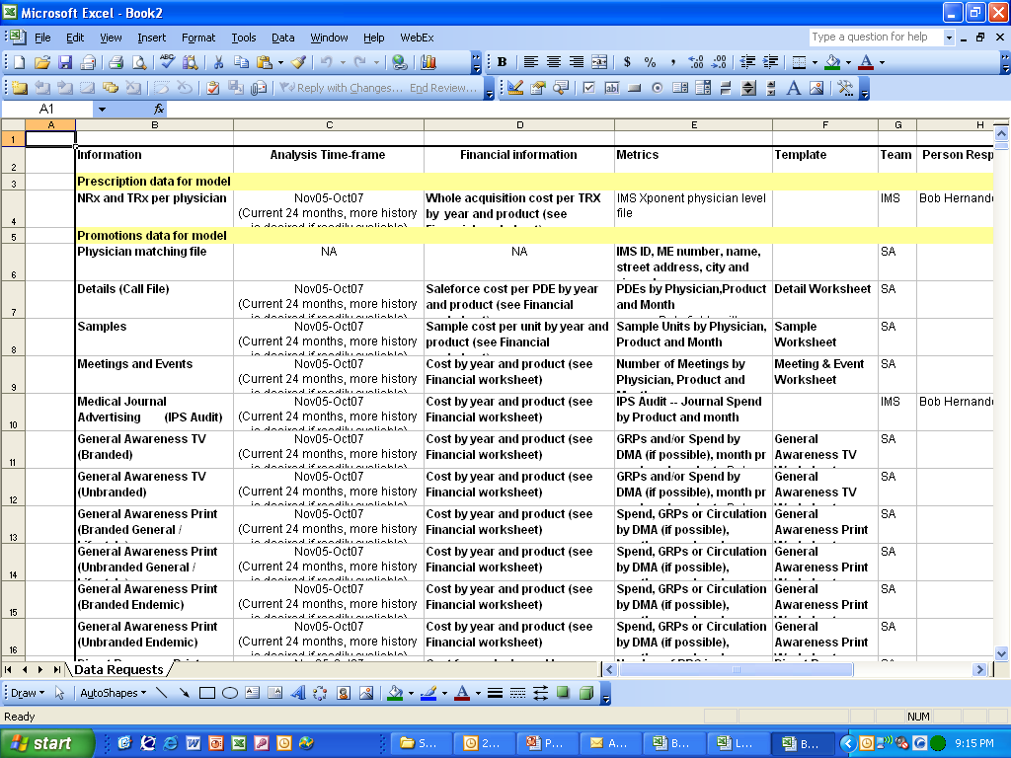
The first step in a promotion mix engagement is to meet with the client, understand the project objectives and determine the necessary data that is required to meet the objectives
Once the key data is identified IMS typically creates a data grid that is passed onto the client and clearly outlines the requirements for each metric

Slide 20
The necessary data typically consists of Rx/Sales data, promotional activity data, cost per unit metrics, historical and future annual promotion budgets and key market events
We require monthly or weekly data with at least two years of history for the modeling
Rx and Sales Data: (Provided by IMS or Client)
Promotional Activity: (Provided by IMS and Client)
  Client provides internal data on channels such as detailing, sampling, dtc advertising, journal advertising, web activity, meetings, etc…
  IMS provides audit data for each channel when applicable
Cost Per Unit Data: (Provided by Client)
  Rx: If Rxs are being modeled then the client should proved the cost per Rx value and any other financial metrics that need to be considered for revenue/ROI purposes (COGS-Cost of goods sold, Operating margin, etc…)
  Promotion: The client should provide the cost per unit values for each channel so that we can calculate total spend
Historical Annual Promotional Spend: (Provided by Client)
  Historical annual spends are used for QC purposes to ensure that we have captured all of the activity data
  It is also used in the simulator as the baseline spend
Future Annual Promotion Spend: (Provided by Client)
  Future budgets are used for understanding the planned promotional spend when developing the forecast
Market Events: (Provided by IMS and Client)
  Identifying all major market events is essential for controlling for extra variation in the model so that we can accurately isolate the impact of promotion.

Slide 21
Day 1 Agenda
Overview of Promo Mix Engagement
Overview of Bayesian Process Flow
Data
  Formatting
  QC
  Exploration
Prior Calculations
Baseline Model Overview
Practice (Data, Priors, Baseline Model)

Slide 22
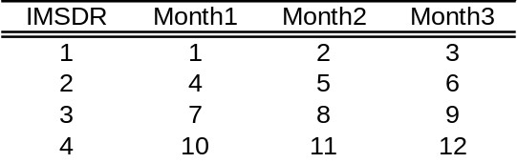
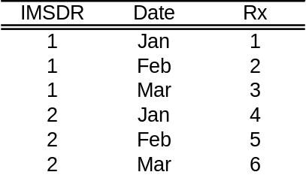
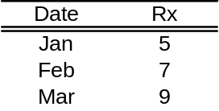
Data Formatting: Once the data is pulled from the IMS audits or received from the client the project team needs to reformat and manipulate it so that it is useable in the modeling
Our mix models require the data to be formatted at the segment/month level
EX: Rx and Sales Data:
  We must manipulate the data and aggregate it to the level of the modeling
  The majority of the projects will use IMS NPA, DDD or Exponent data
  NPA/DDD data will be pulled through Dataview at the national level and will need to be transposed so that each record is a month
  Exponent data will be pulled by a team member and will need to be transposed and aggregated from the physician level to the required modeling level
Example: Exponent Data Physician Level Model National Level Model

Slide 23
Day 1 Agenda
Overview of Promo Mix Engagement
Overview of Bayesian Process Flow
Data
  Formatting
  QC
  Exploration
Prior Calculations
Baseline Model Overview
Practice (Data, Priors, Baseline Model)

Slide 24
Data QC: Clean and accurate data is essential to the success of a promotion response model
Once the data is formatted correctly we run various QC processes in order to ensure that we have complete and accurate data
Steps for QC
Create time-series charts of all variables in order to confirm allocation over time and to identify any major trend breaks.
Create segment level (Spec, Geographical, etc…) and national level totals for each variable. Confirm totals with client.
Apply the unit cost to each variable in order to calculate the spending control totals. Compare these totals to the client provided annual spends in order to ensure that we have all of the data.

Slide 25
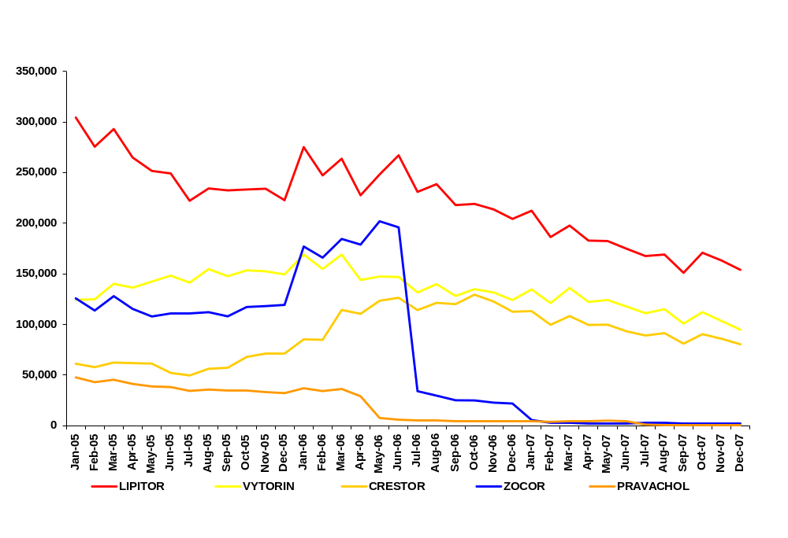
Charting the data
Charting the Rxs/Sales for each product in the market will provide a visual representation of the historical trends and provide a cross check of the data pulls
Statin Market: Branded products
In this example we can easily see a major trend break in the data in 2006. Upon further investigate we confirmed that this was due to a generic entry. Therefore, we confirmed that the break was not due to a programming error.

Slide 26
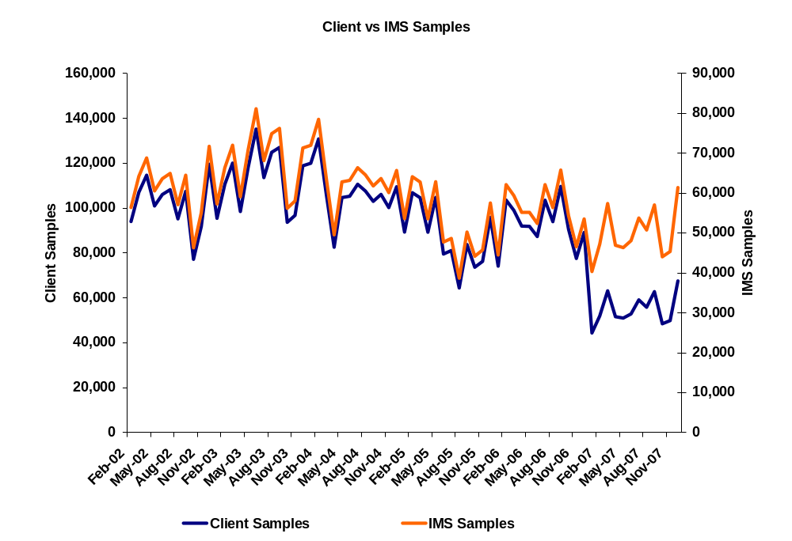
Charting the data
We plot each promotional channel over time in order to get a sense for the historical marketing effort and strategy. If comparable IMS data is available we try to chart the IMS data vs. the client data. The scale of the two series will not always be the same since the IMS data is audit data, but the trends should be similar.
From this graph we can see that the client samples activity seems odd in 2007. Being that the two data series trended together pre-2007, we could hypothesize that we may not have been given a full set of samples data in 2007. We will present this to the client and probe around this issue.

Slide 27
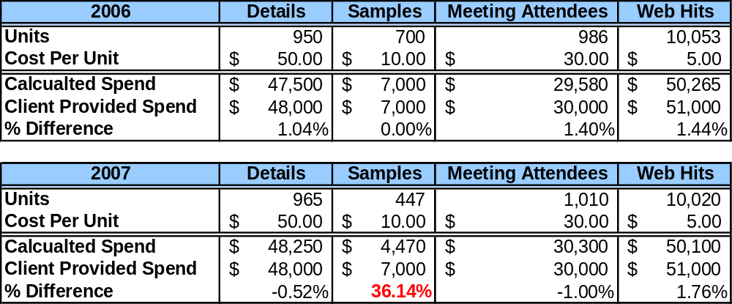
Creating control totals and applying financial metrics
For each year in the modeling period we will create control totals and compare them to the client’s expected totals
In this example we can see that the calculated samples spend in 2007 is drastically lower than the client’s stated budget. This squares with what we saw in the time series chart on the previous slide. Again, we would share this table with the client and probe around the samples so that we can discover the reason for the discrepancy.

Slide 28
Day 1 Agenda
Overview of Promo Mix Engagement
Overview of Bayesian Process Flow
Data
  Formatting
  QC
  Exploration
Prior Calculations
Baseline Model Overview
Practice (Data, Priors, Baseline Model)

Slide 29
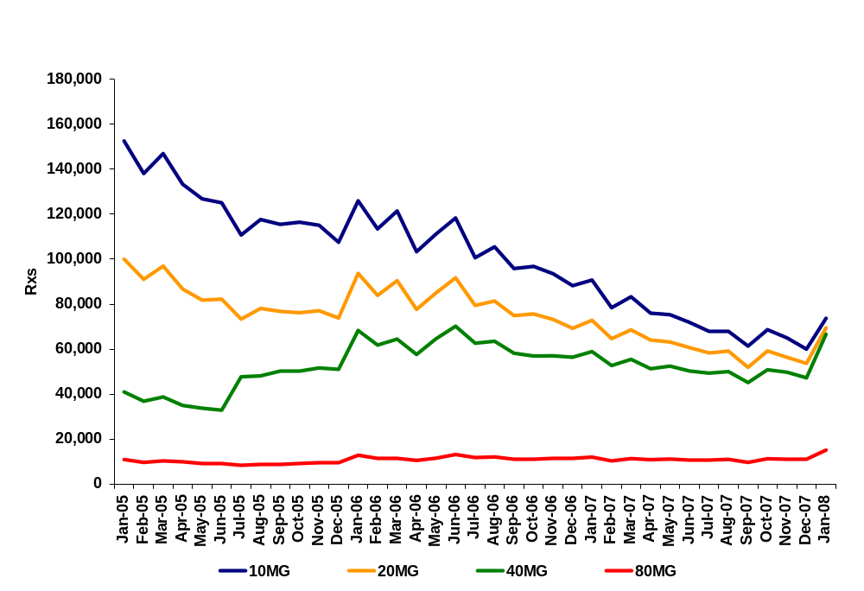
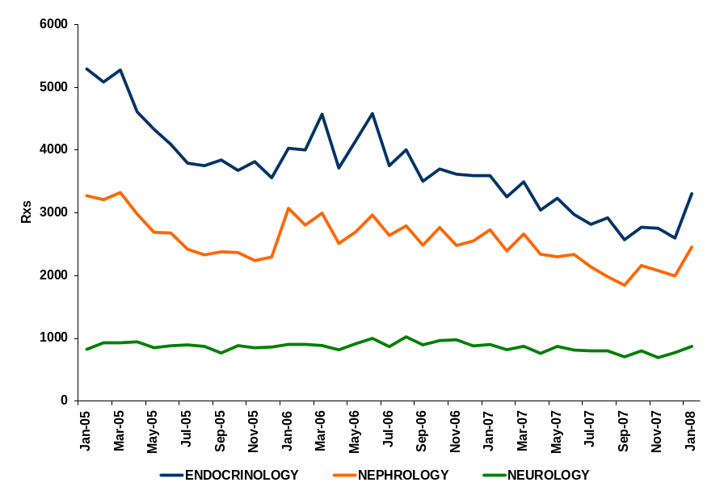
Exploratory Data Analysis
Once we have confirmed that we have full and accurate data, we generally examine multiple break outs of the data in order to get a full understanding of the product dynamics. This may provide valuable insights and ultimately may warrant a change in the modeling approach.
From these two charts we can see that the Neurology and 40mg segments of this product do not share the same declining trend as the other segments. This should be shared with the client. Perhaps their messaging in their details are geared towards Neurological issues or perhaps about the benefits of the 40mg strength. This may warrant a breakout by spec and/or strength when modeling so that this impact is not lost in aggregation.
Notes:
Mg: different dosing.

Slide 30
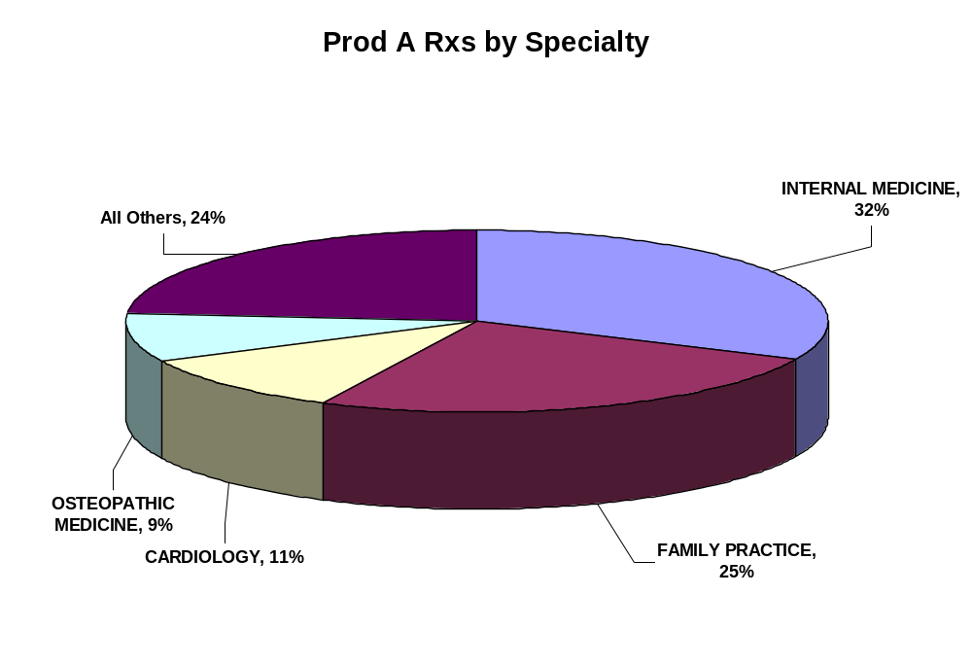
Exploratory Data Analysis
Creating pie charts of the data by segment gives insight into the percentage of volume that flows through each segment. This exercise can provide guidance around which segments can or can not be collapsed.
In this example we can see that most of the volume flows through the PCP specialties (IM, FP, OM). Therefore, we can discuss with the client the possibility of creating a PCP bucket and further collapse the specialty segments into a total of three groups.

Slide 31
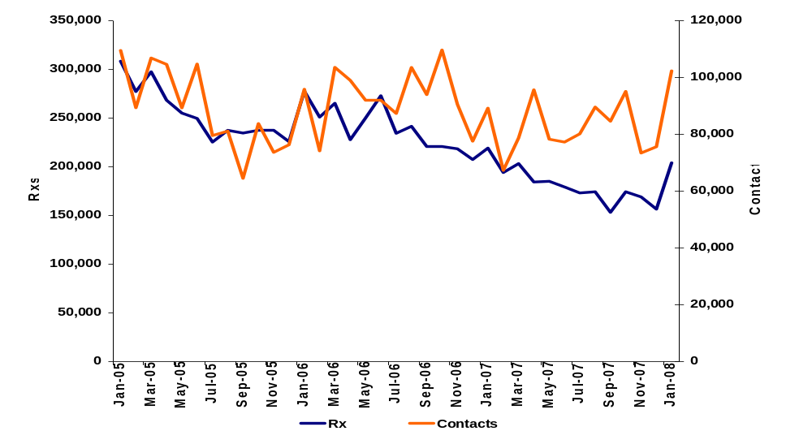
Exploratory Data Analysis: Once it is determined which level the data will be aggregated to for modeling, we begin to look into the relationships between the variables themselves
Bivariate time-series charts between the dependent and independent variables provide a graphical representation of the correlation between the two series.

Slide 32
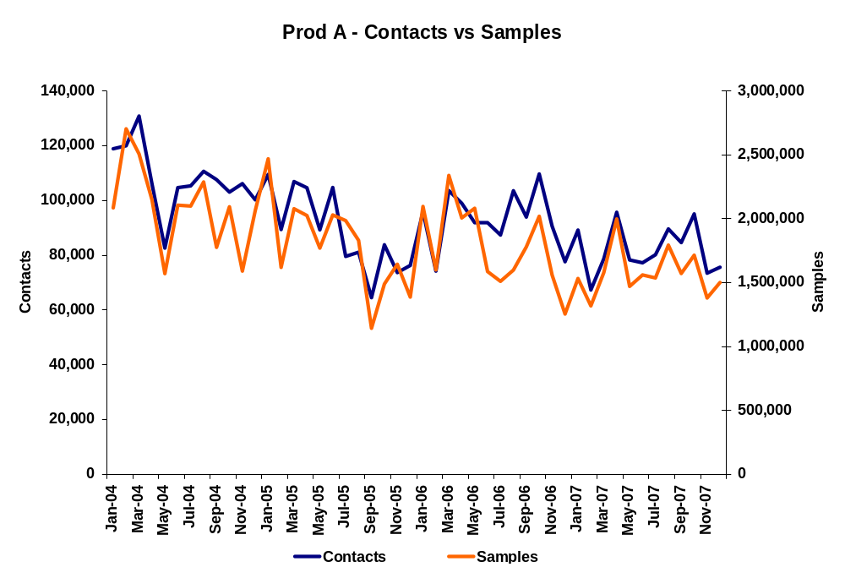
Exploratory Data Analysis: Likewise, bivariate charts between the independent variables provide insights into the levels of collinearity
This chart clearly shows high correlation between contacts and samples which should be considered when modeling.
Notes:
不同的segment下面，contact和samples之间的相关性可能会有不同。 比如在national level下会correlated，但是在
DMA下，可能就不是correlated

Slide 33
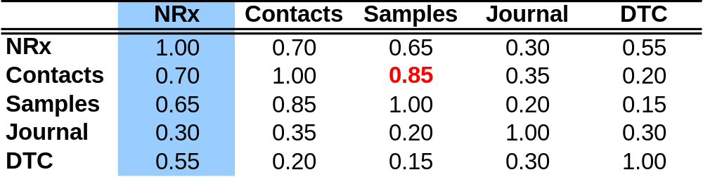
Exploratory Data Analysis: In addition to the charts, a correlation analysis should be run on all variables in order to quantify what is seen in the graphs
Correlation Matrix: Pearson’s Rho
Looking down the NRx column we can see that contacts and samples are the most correlated with NRxs. This gives an initial hypothesis on the largest drivers of sales before we begin the modeling process.
We also see that contacts and samples are highly correlated (0.85) as we had seen in the time-series chart.

Slide 34
Day 1 Agenda
Overview of Promo Mix Engagement
Overview of Bayesian Process Flow
Data
  Formatting
  QC
  Exploration
Prior Calculations
Baseline Model Overview
Practice (Data, Priors, Baseline Model)

Slide 35
Prior Calculations: Once the data is ready for modeling we calculate “prior” contributions that help the project team deal with many difficulties that are inherent in a promotional mix model
The main objective of a promotion response model is to estimate the individual contributions that each channel has on sales performance
So unlike other regression based models where the analyst’s goal is to build a parsimonious predictive model with the best subset of available variables, the promo mix model has a set number of variables that must be included in the model
This situation causes a major problem that all marketing mix analysts have to deal with. While all promotions should yield a positive impact on sales, issues such as multicollinearity make it extremely difficult to disentangle the individual impacts and produce reasonable estimates
For this reason we are currently leveraging a Bayesian model which utilizes prior estimates for the contributions that assist the model at generating reasonable results

Slide 36
Prior Calculations: The priors are based off of past experience and sound business hypotheses
With the understanding that a regular OLS regression model may have difficulty disentangling some variables in order to generate accurate estimates, the analyst needs to derive some baseline assumptions for the expected contribution of each channel
Ideally the team will work with the client in order to gain some insider perspective on the expected contribution. In addition, the client may have some past results that provide generally accepted estimates of the contributions
However, in most cases we do not gain this perspective from the client so we need to make some reasonable assumptions
Generally, our assumption is that the client has historically made educated decisions when executing marketing plans and determining promotional levels
Therefore, we assume that the client knows what they are doing and that they are currently operating under an optimal mix
In statistical terms this means that each channel has a marginal return on investment (MROI) of 1.0. This means that any additional spend would be unprofitable and any decrease in spend would result in a loss of revenue that is greater than the savings due to the decrease in spend

Slide 37
Prior Calculations: The Bayesian methodology considers both the prior assumptions and the data in order to arrive at the final estimate
In statistical terms the prior can be thought of as the Null Hypothesis. Assume that the client is operating optimally unless the data can disprove the hypothesis
The prior contribution is not solely a point estimate. We build a distribution around it with an assumed variance (width). The width of the distribution determines the strength/influence that the prior has in the final estimation.
This distribution can basically be thought of as a 95% confidence interval. We will expect the final estimate to fall somewhere in this range unless there is overwhelming evidence in the data to pull it out
So ultimately, you can think of the prior as a tool that points the model in the right direction. The data takes over from there and pulls the estimate up or down from the prior assumption

Slide 38
Prior Calculations: Algorithm
Our promo mix models utilize a Fractional Power model structure. Under this model structure the MROI for a given channel can be easily calculated by the following equation:
  MROI = ROI * ROOT
  Where the root is the power coefficient for the respective channel. This estimates the level of diminishing returns
If our Null Hypothesis is that the client is operating optimally then the prior assumption on the MROI is 1.0. Unless we have information about the approximate value of the root, we generally us 0.5 since it lies in the middle of the (0,1) range
Therefore, using this example and solving for ROI, ROI = 1 / Root = 2.0
Contribution % is defined as:
  Contribution % = (ROI * Spend) / Total Product Sales
So we have all of the necessary pieces to calculate the prior contribution under the null hypothesis

Slide 39
Prior Calculations: Algorithm
Now that we have our prior contribution, we need to calculate the distribution around this mean
The Bayesian model requires the user to input a value for a prior precision which is equal to the inverse of the variance
Therefore, the analyst needs to make some assumptions around the variance or width of the distribution
A 95% confidence interval is approximately defined as the mean +/- 1.96 * stddev
We generally estimate 1.96 stddev to be equal to the mean multiplied by some width. Our default is 0.75 of the mean. Under this assumption +/- 1.96*stdev for a prior contribution of 0.20 would be (0.05, 0.35)
We can then divide 1.96*stdev by 1.96 in order to arrive at the stdev
Finally the precision is 1 / (stdev^2). This, along with the prior contribution is passed to the Bayesian model

Slide 40
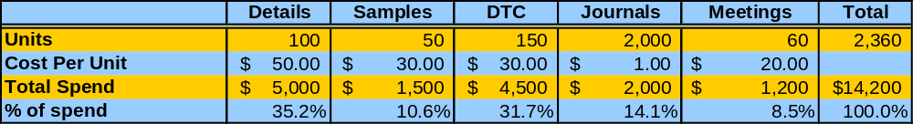
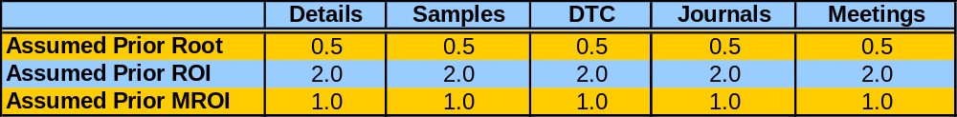
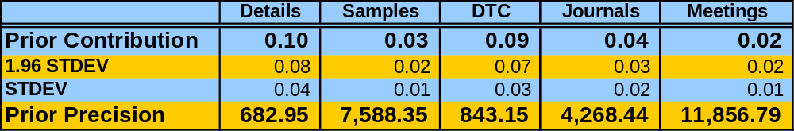
Prior Calculation: The following is an example of a table which calculates the prior values
We can start our calculations by building off of the data summaries that we created in the data QC process
Prior assumptions for a 1.0 MROI (MROI = Root * ROI)
Prior Contribution and Precision Calculations (1.96STD = 0.75*Contribution)
So a 10% contribution from details would yield a 2.0 ROI and a 1.0 MROI given a 0.5 root.

Slide 41
Day 1 Agenda
Overview of Promo Mix Engagement
Overview of Bayesian Process Flow
Data
  Formatting
  QC
  Exploration
Prior Calculations
Baseline Model Overview
Practice (Data, Priors, Baseline Model)

Slide 42
Before diving into the full promotion mix model we develop a baseline model which aims at isolating all trends and events as well as the top few promo channels
The theory is that all major events and the channels should be well identified. Therefore, if we can start by getting a good read on those factors then we can start adding in some of the smaller channels.
Goals of the Baseline Model
Understand all market events and trends, determine the appropriate coding and get an initial read on their impact
Generate initial reads on the top 1- 3 channels before adding in the rest of the variables and introducing potential collinearity
Cross check the initial results against the priors for a sanity check. If the two are drastically different then the analyst may want to investigate deeper into the model or reconsider the prior values.
The baseline model uses a regular OLS regression in SAS and not a Bayesian approach. This provides an objective approach to understanding the main channels.

Slide 43
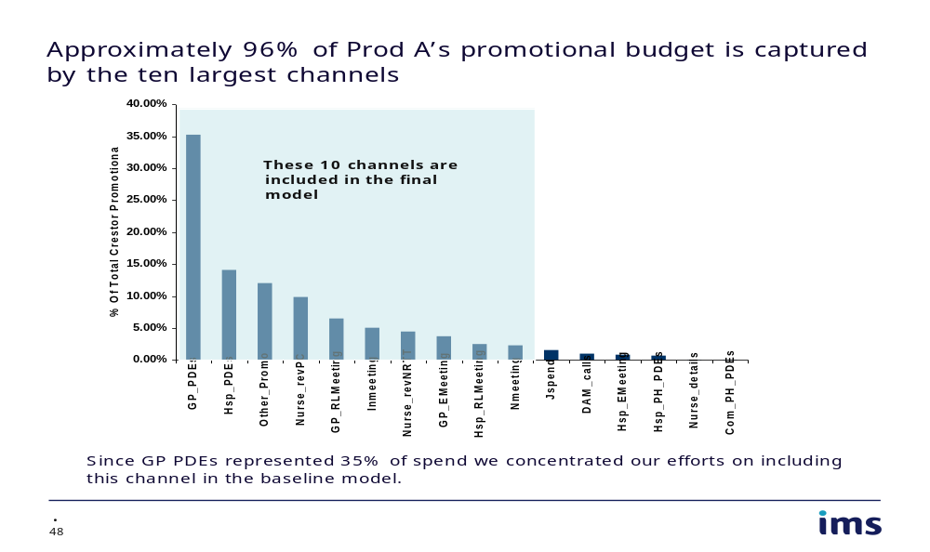
Once we have determined the key market events through research and discussions with the client, we need to determine where the client has historically spend their promotional dollars
The top 1 – 3 channels will be included in the baseline model

Slide 44
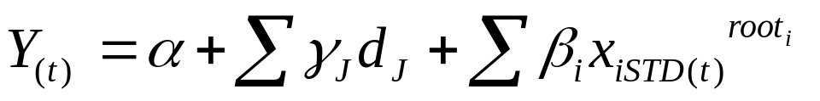


As previously mentioned, we conduct our modeling using a separatable Fractional Power model which estimates the impact of each variable as well as its level of diminishing returns
Fractional Power (Fractional Root) Model
= Rxs or sales at time t
= intercept
d = control variables
X_{STD} = standardize promotion stock variables

Slide 45
Before passing the data to the model we need to do some important transformations
Size Adjusting: When working with sub-national data we rescale the data according to the some measurement of segment size. Typically, we leverage something like the population size for each segment.
Stocking: We utilize a stocking algorithm which transforms the promotional data by considering some sort of carry over rate from prior promotional efforts. This allows us to estimate both short-term and long-term effects of promotion.
Standardization: Finally we standardize the data for interpretation reasons. When running a model, an analyst typically runs multiple iterations. By standardizing each variable by its own mean, the parameter coefficients can be interpreted as an approximate contribution. This will allow the analyst to gain immediate insights into the model results.

Slide 46
Size Adjusting the Data: When modeling at the sub-national level we adjust each variable by a metric which represents the size of each segment
Size adjusting the variables allows for a more accurate detection of the differences across the regions by minimizing the differences in scale amongst the regions.
  The sub-national promotional variables are size adjusted by dividing the raw promotional data by the regional population size.
  Adjusted promo = Raw promo / Regional population
  The national promotional variables are not size adjusted because the promotional effort is the same across the different regions.
  Adjusted promo = Raw promo / 1

Slide 47
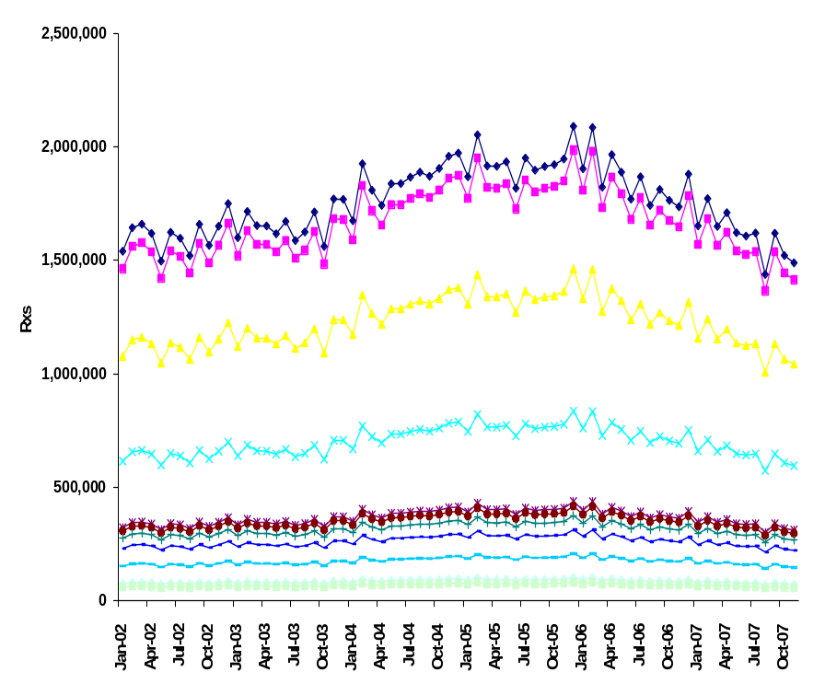
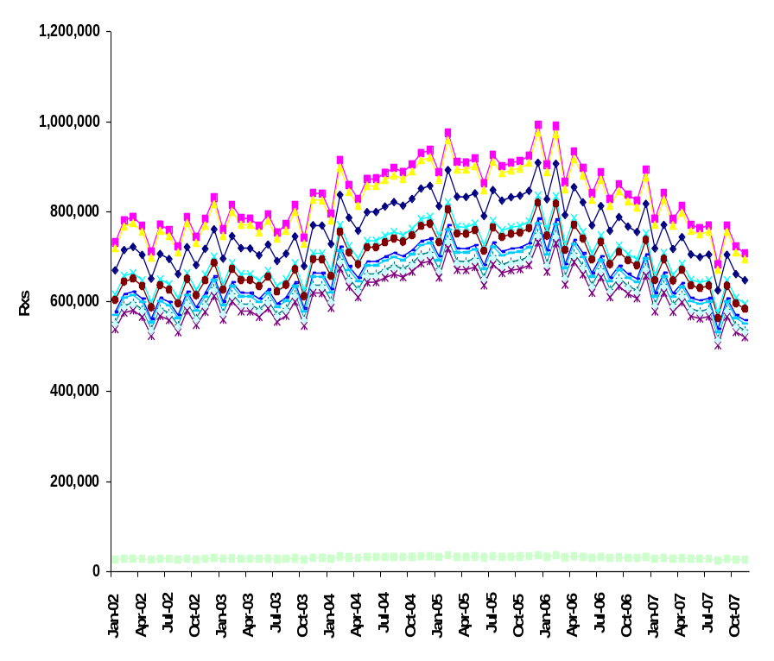
Size Adjusting the Data: By size adjusting the data we also normalize the data so that the normality assumption of the model is met
For example, consider the following Rx data by segment:
Not Size Adjusted
Size Adjusted
By size adjusting we have accounted for most of the cross-sectional variance and have created data that should meet the normality assumptions. Now the model should concentrate on the time-series correlation between promotion and sales.

Slide 48
After adjusting for differences in segment size, we calculate Promostocks in order to capture the long term impact of promotions
Promotion typically has carry-over effects beyond when the promotion takes place
The carry-over mechanism can affect brand performance in two ways:
Short-term
During the time of
the promotion
Incremental Rx
Longer-term
Delayed/lagged effect
Build awareness over time among physicians
Repeat Rx
Equity

Slide 49
The promo stocks are calculated by considering a certain carry over rate that is applied apply to prior spend
K_{t}=r K_{t-1}+(1- r )X_{t}
Promostocks
Retention Rate
Promotional Spend

Slide 50
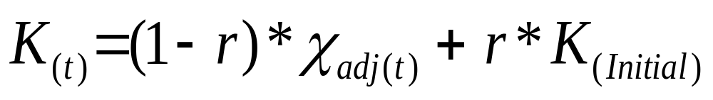
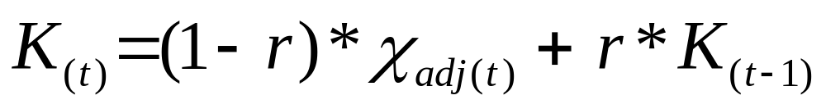
In cases where we do not have promotional data prior to the modeling period we need to estimate the level of the stock in the beginning of the modeling period
Creating an accurate starting stock is critical so that the modeled promotional series captures the actual trend in the historical promotional investment.
The initial stock value is set as the average of the first few months of the modeling data for each segment (The default is the first 3 months).
Finally, using the retention rate that we determined based on knowledge of the product/market and an iterative model fit analysis, we build the promo stock using the following algorithm:
If t = 1
If t > 1

Slide 51
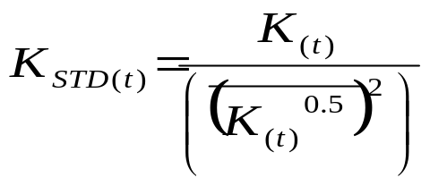

Finally, the stock variable is standardized for interpretability reasons
The stocked variables for each segment/month observation are standardized by the (average of the square root of the stock over the entire dataset)^2.
This standardization is done under the assumption of having a root equal to 0.5. We choose 0.5 since this is the midpoint of the root’s range. The true root will be estimated during the modeling process.
This process allows the parameter estimates to reflect the approximate contributions for each promotional variable.
This standardized variable is then passed to the model for estimation.

Slide 52
Day 1 Agenda
Overview of Promo Mix Engagement
Overview of Bayesian Process Flow
Data
  Formatting
  QC
  Exploration
Prior Calculations
Baseline Model Overview
Practice (Data, Priors, Baseline Model)

Slide 53
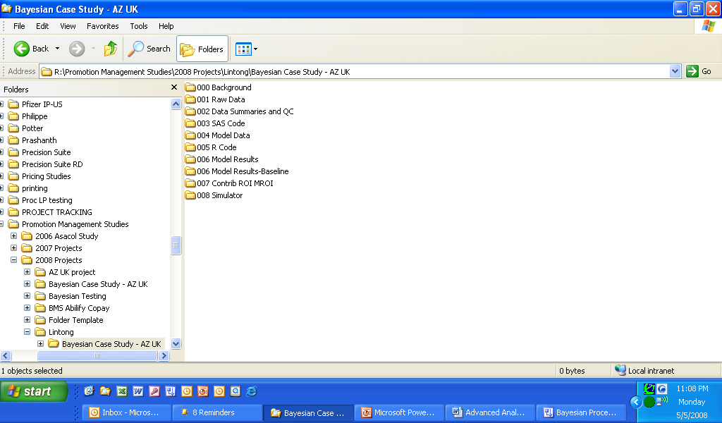
Practice: Read in Data, QC Data, Create Priors, Baseline Model
AZ UK – Nexium Case Study
A folder for each of you has been created in the following location
R = \\plyvnas01\\statservices

Slide 54
Practice: Read in Data, QC Data, Create Priors, Baseline Model
AZ UK – Nexium Case Study
Read in Data:
- 001 Raw Data\Nexium 22apr08 001_Nigel_lihuarevised.xls
- Read in data and create SHA (segment) /month level dataset consisting of rxs, sales and promotion data
QC Data:
- For this example, we were not given financial data in order to run our full QC
- So for this example, simply chart the data in order to QC that it has been read correctly
- Run some exploratory analyses
Create Priors:
- Using the created dataset, set up the prior calculations
- Consider Rxl_GBP_total as the “sales” variable
Develop Baseline Model
- 003 SAS Codes\Step2 Baseline Model - Master.sas
- Consider RxI_CUdv28 to be the dependent Rx variable
- Include GP_details, Hsp_PDEs and any relevant controlling variables

